Slide 1


Slide 2

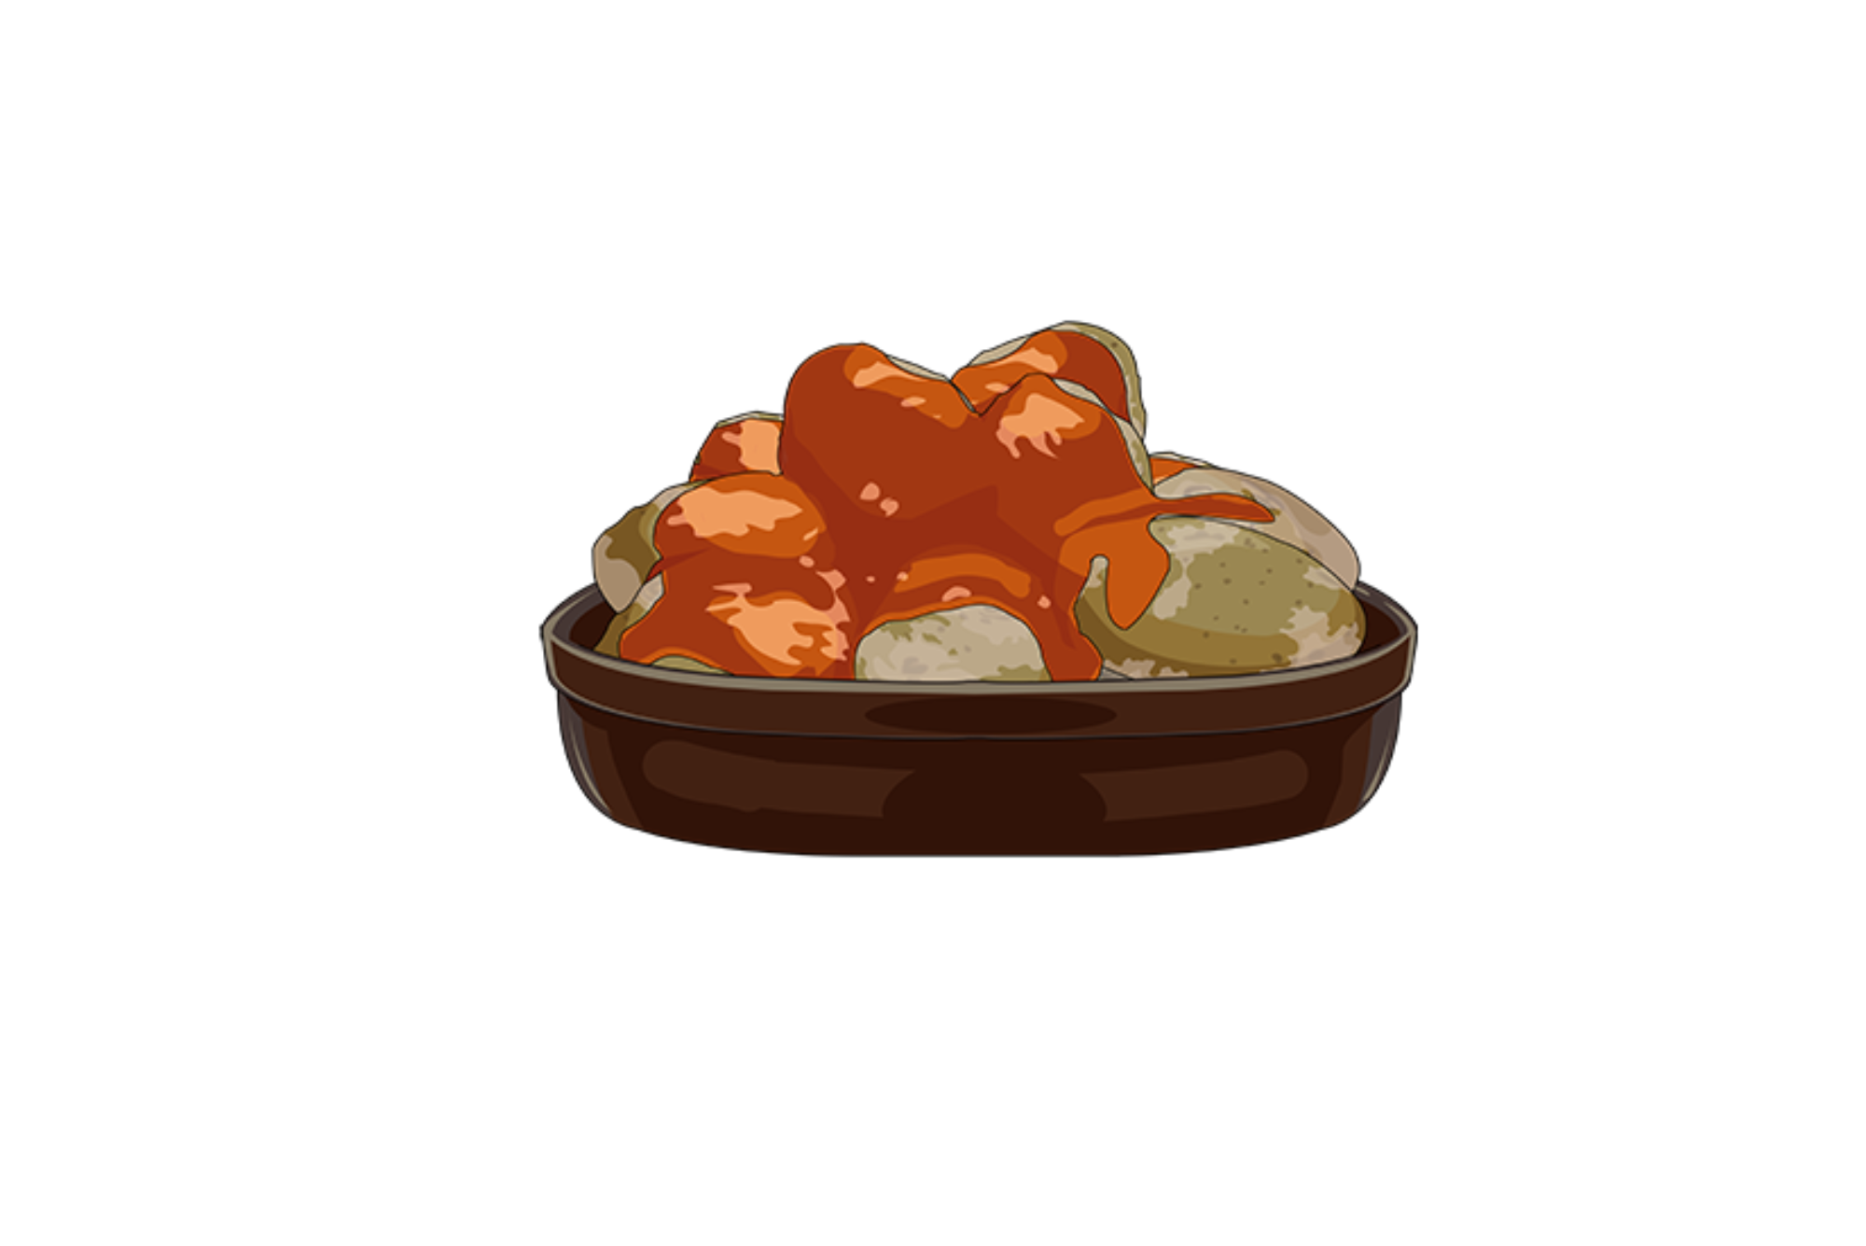


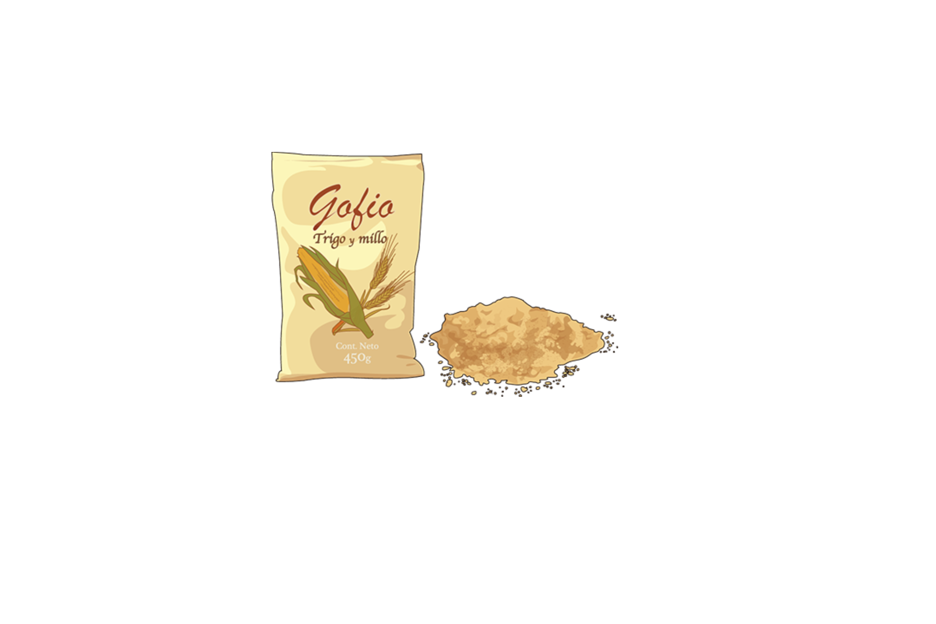



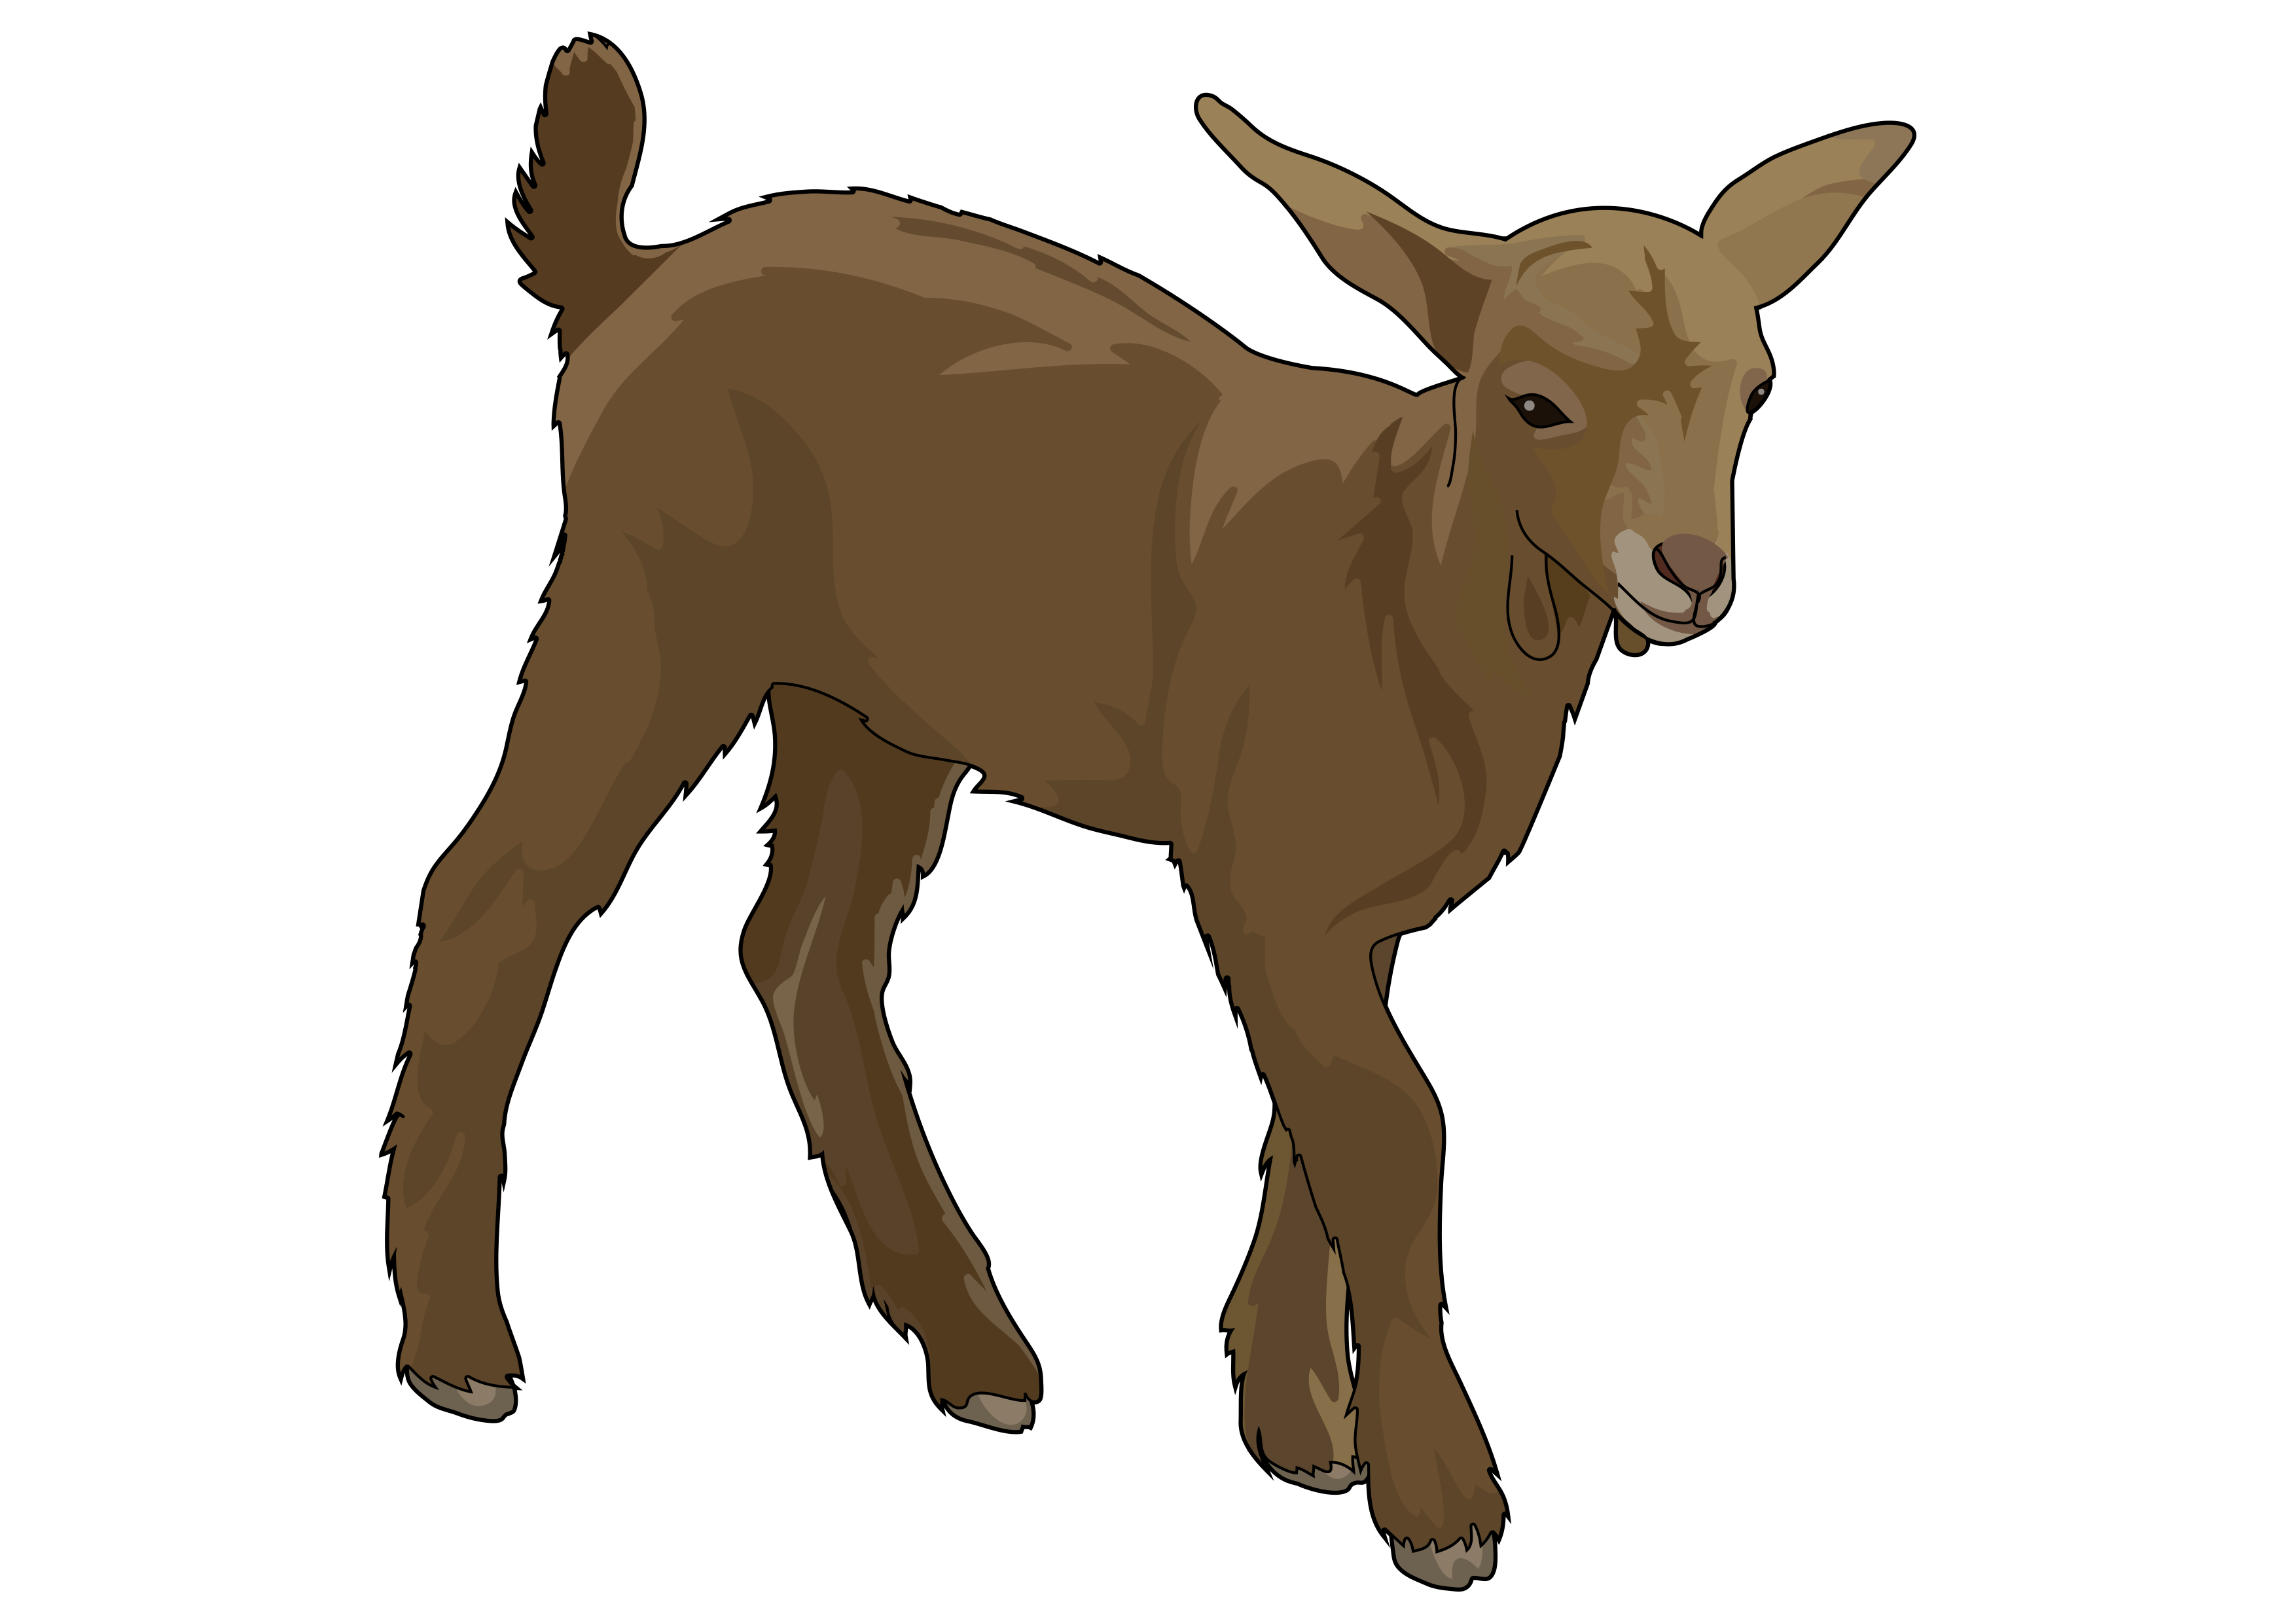

DO YOU WANT TO TAKE A CARD?
PRESS THE BUTTOM AND REPEAT WITH THEM
PRESS

Slide 3
DO YOU WANT TO TAKE A CARD?
PRESS THE BUTTOM AND REPEAT WITH THEM
PRESS

Slide 4
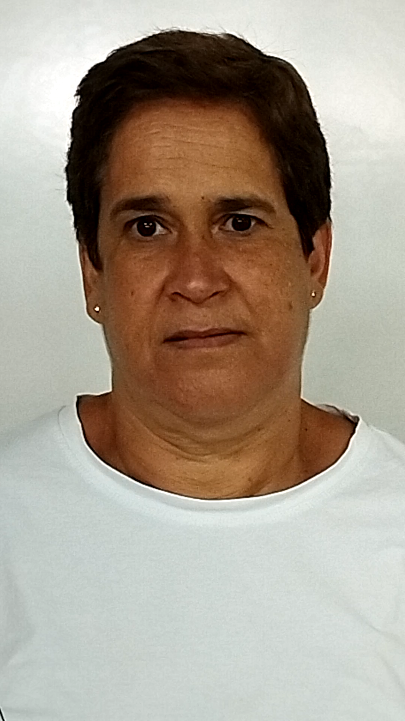
FREZZER
PELETE

Slide 5
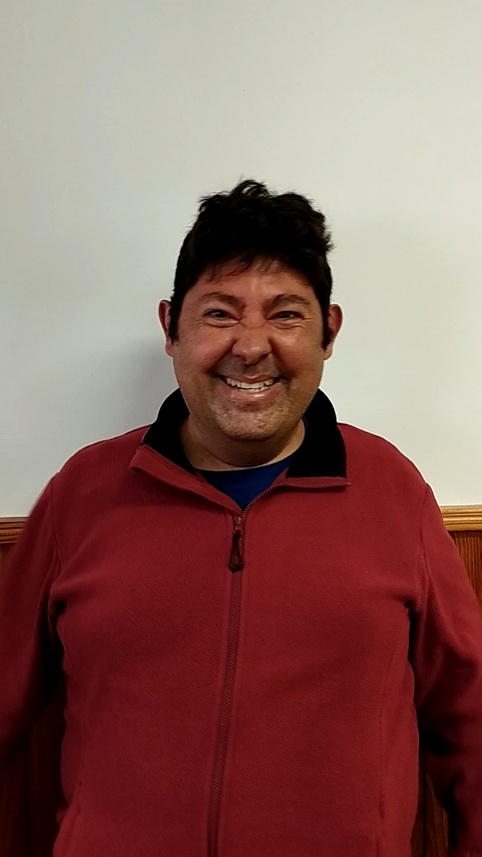
CORN
MILLO

Slide 6
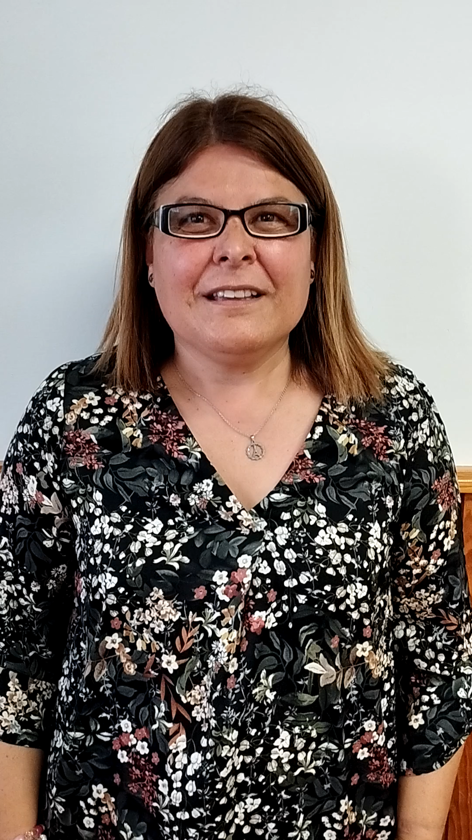
TOASTED FLOUR
GOFIO

Slide 7
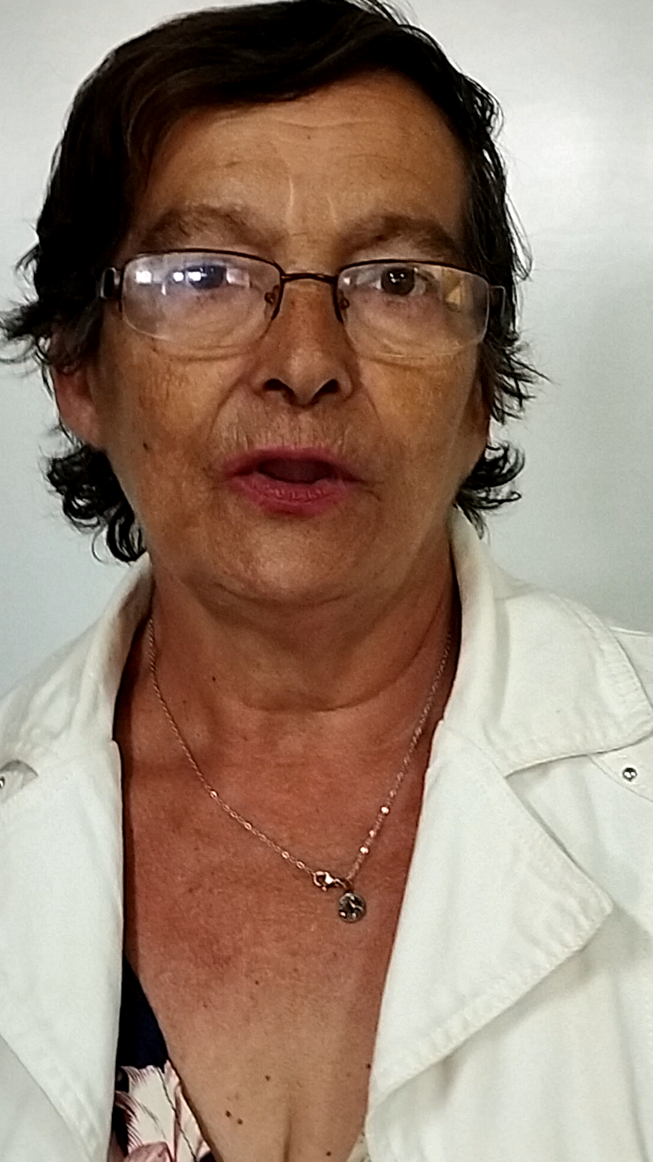
POP CORN
COTUFA

Slide 8
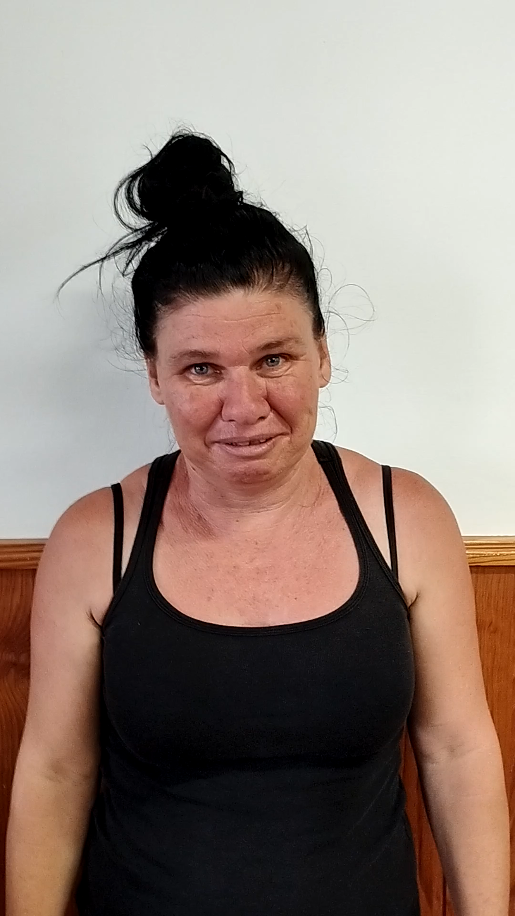
LITTLE GOAT
BAIFO

Slide 9
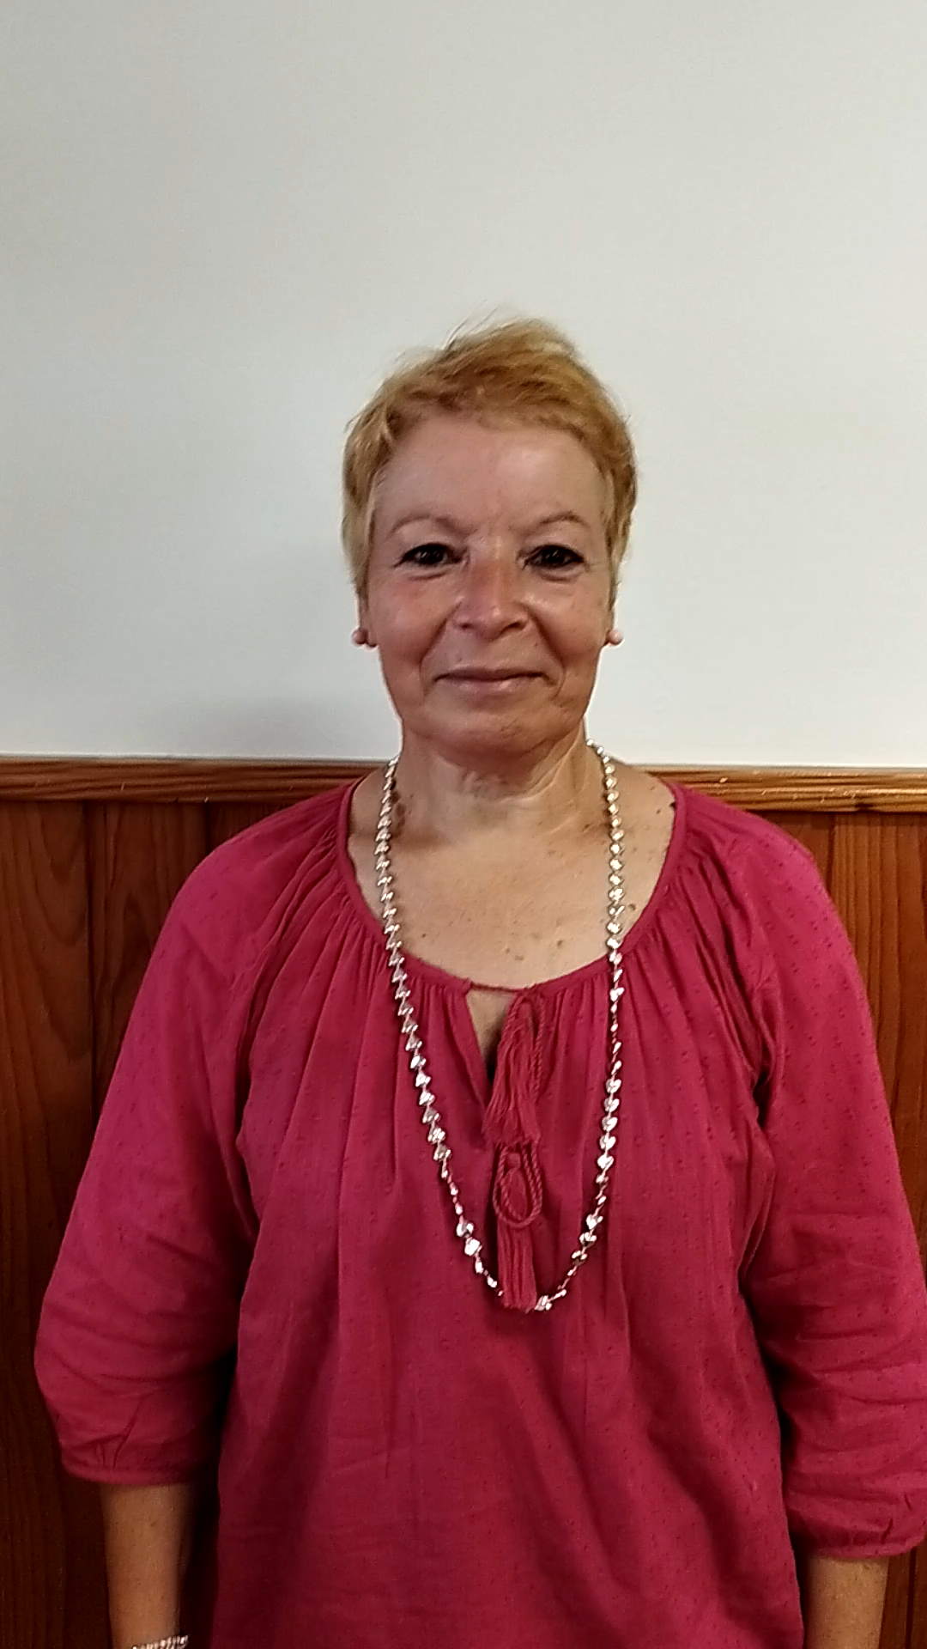
BOILED POTATOES
PAPAS ARRUGADAS

Slide 10
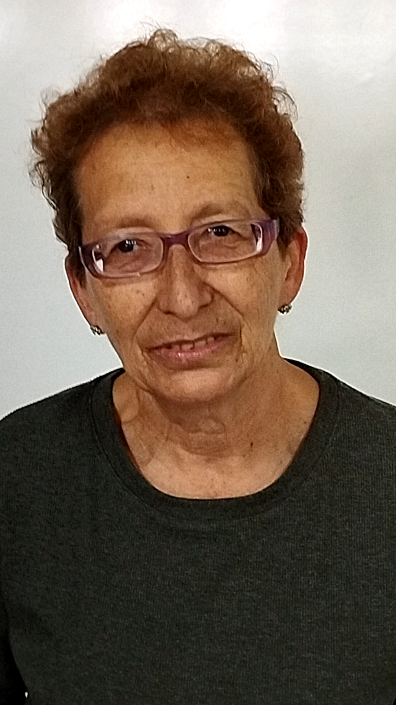
TO BE HUNGRY
JILORIO

Slide 11
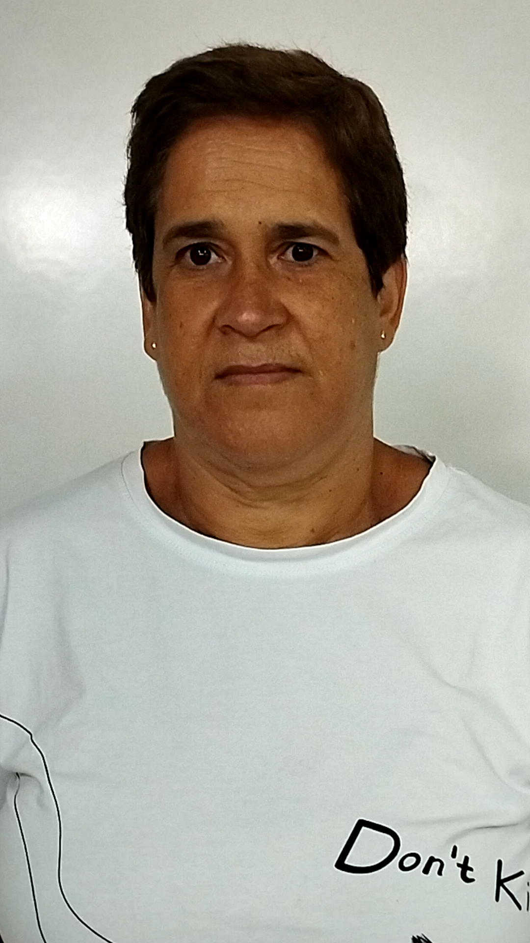
FLIP FLOP
CHOLA

Slide 12
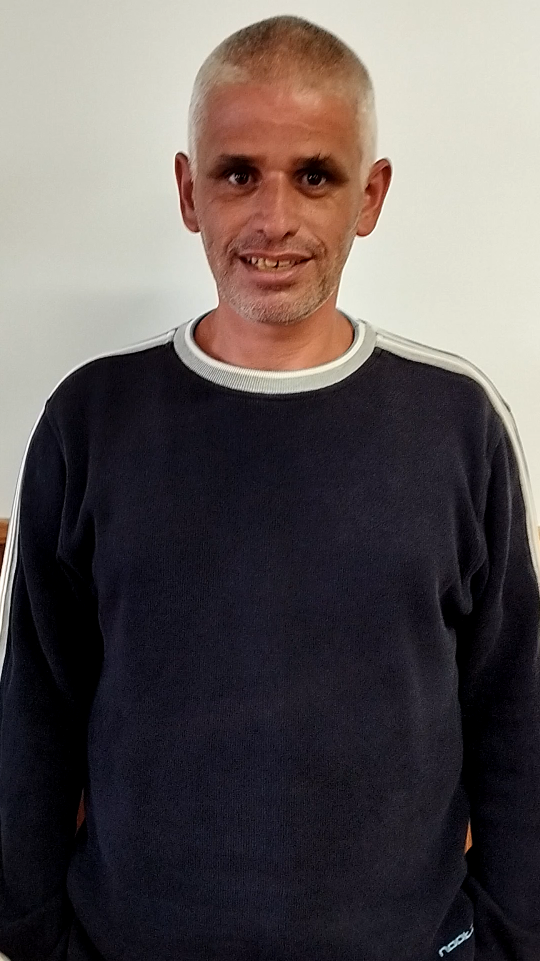
FOOL
TOLETE

Slide 13
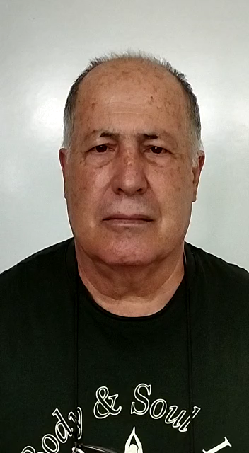
BUS
GUAGUA

Slide 14
Good job!
NOW…
Choose your card

Slide 15
Sorry!
You have to improve your canarian language
Press the buttom and try again

