Slide 1
„How EU works” - Giant JENGA
Szent István tér 17. Pécs
Educators’
Centre
Association

Slide 2
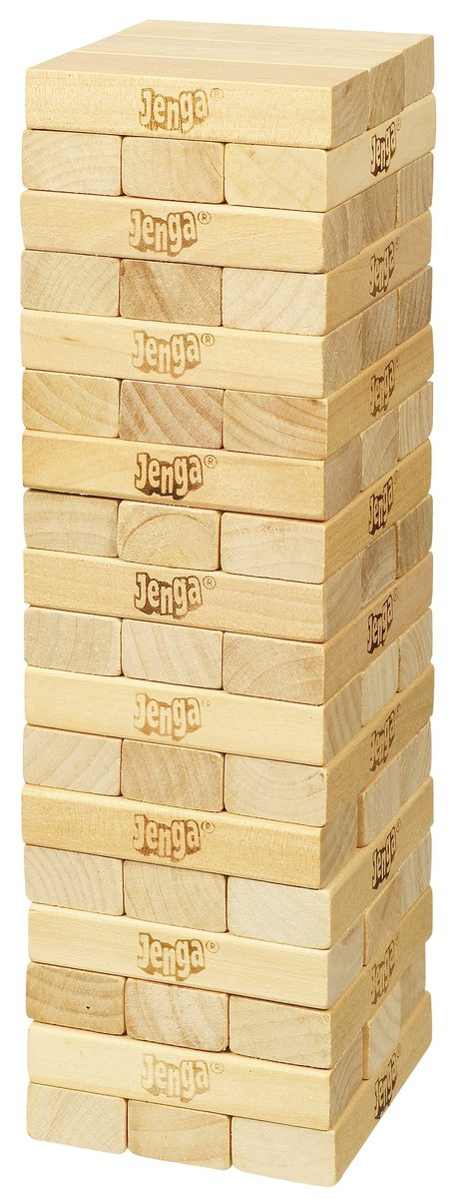
Jenga is a game of physical skill
Players take turns removing one block at a time from a tower. Each block is removed then placed on top of the tower, creating a progressively more unstable structure.
The game ends when the tower falls

Slide 3
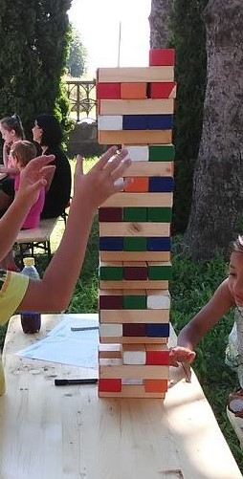
„How EU works” – Giant Jenga
Besides to the construction of the Jenga tower – players gain information about the structures , functioning and values of the EU.
Players: 3-16 (in groups or as single player)
Duration: 30-60 min

Slide 4
Rules
Throw the dice , pick a card and answer the question
(1) you miss a round
(2-5) pick a card and answer the question
(2) orange card – 2 points, easiest
(3) blue card – 3 points
(4) green card – 4 points
(5) red card – 5 points, hardest questions
(6) you can throw twice

Slide 5
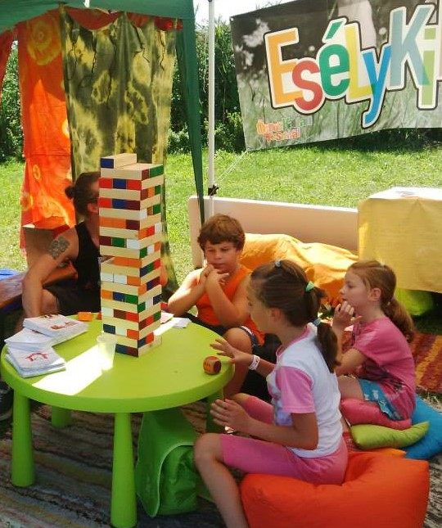
Rules
The quizmaster checks the answers and adds additional knowledge to the question
2) if you answer well, taking one block on a turn from any level of the tower (except the one below an incomplete top level), and
3) placing it on the topmost level in order to complete it: plus 1 point
• The game ends when the tower falls -- completely or if any block falls from the tower (other than the block a player moves on a turn): minus 10 points
• Count the points and find the winners

Slide 6
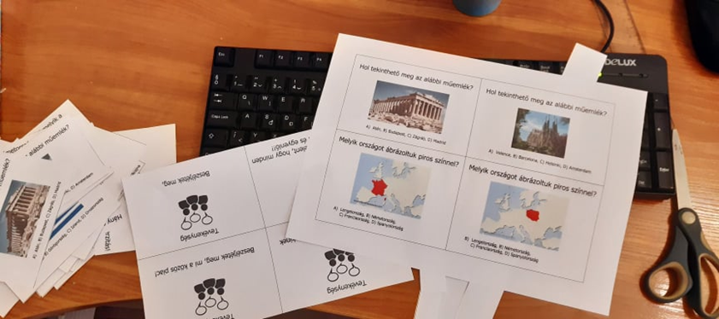
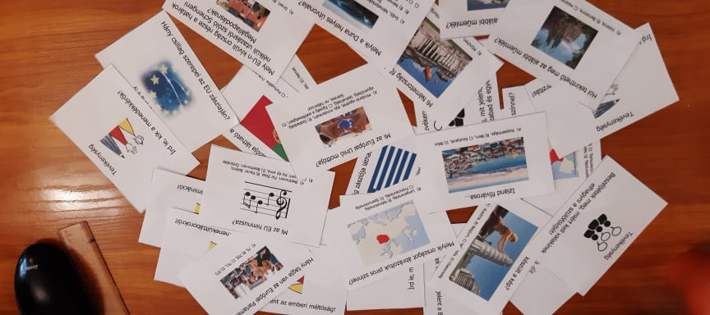
Process…

Slide 7
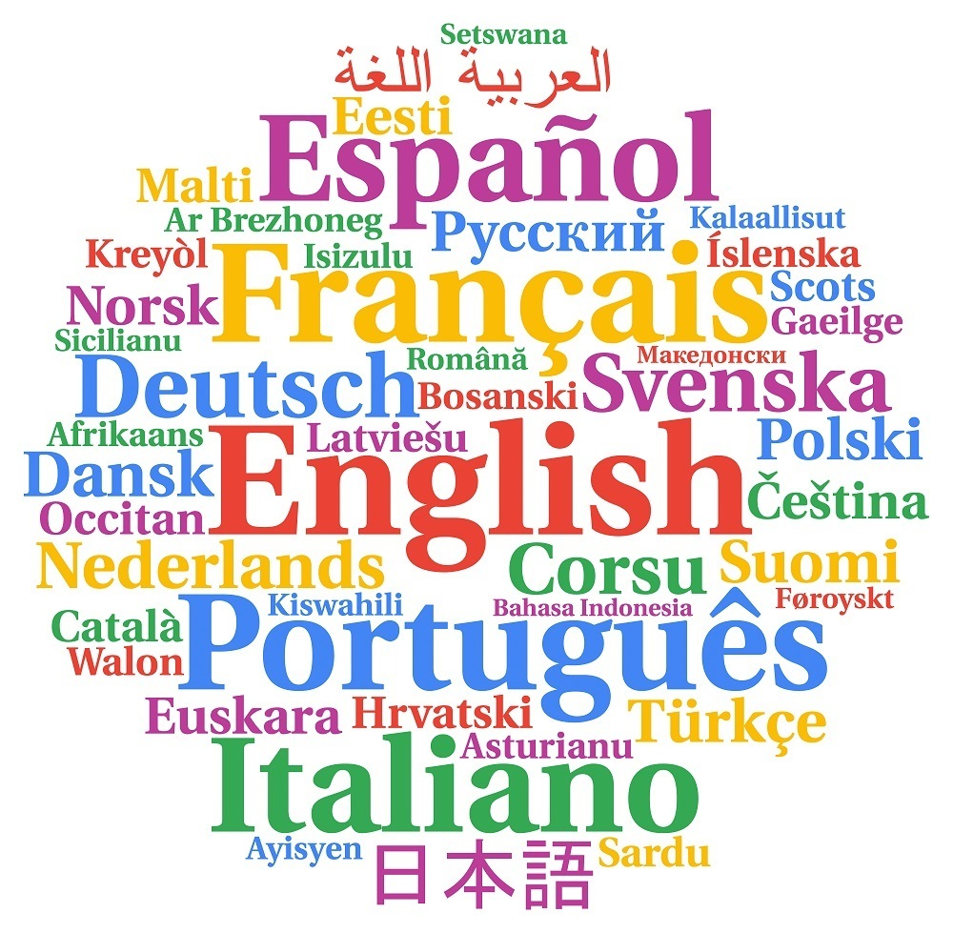
Sample questions
How many official languages does the EU have?
a) 19
b) 23
c) 24

Slide 8
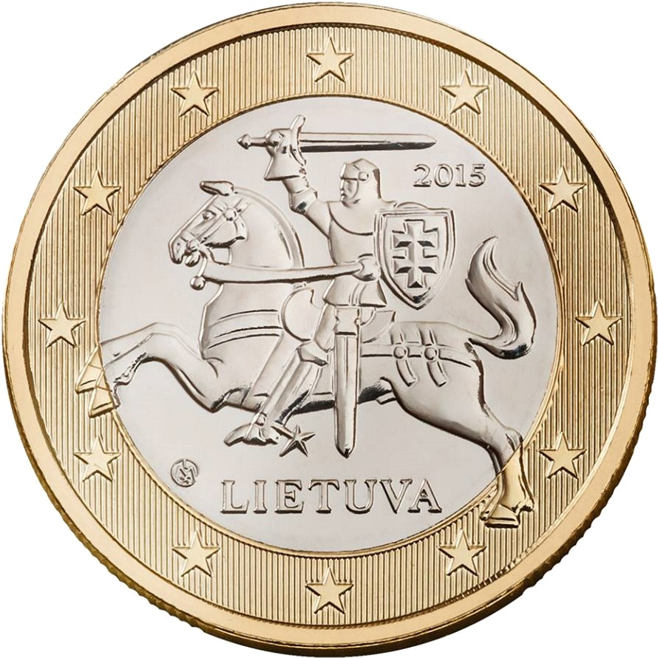
Sample questions
Euro banknotes and coins were introduced in 2002 and are now used in 19 EU countries. The coins have a common side, showing a map of Europe, but each country has its own design on the other side.
Guess, where is this coin comes from?
a) Germany
b) Slovakia
c) Lithuania
d) France

Slide 9
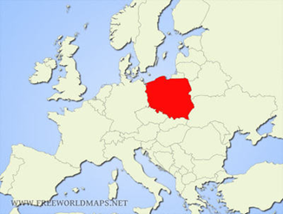
Sample questions
Which country is shaded in red?
a) Poland
b) Slovakia
c) Czech Republic
d) Denmark

Slide 10
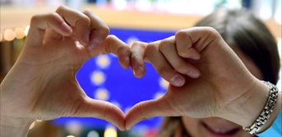
Sample questions
What is the motto of the EU?
a) All for one and one for all
b) Liberty, Equality, Fraternity
c) United in Diversity
d) Make love not war

Slide 11
Sample questions
Every year the EU celebrates its birthday on 9 May.
What is the name of the man who, on 9 May 1950, put forward the plan considered to be the beginning of what is now the European Union?
Alcide De Gasperi
Robert Schuman
c) Konrad Adenauer
Europe Day
Today’s European Union can be traced back to the proposal for the production of coal and steel to be jointly managed, presented on 9 May 1950 by France’s then foreign minister Robert Schuman. By deciding together what to do with Europe's coal and steel, no single nation could build weapons without the other nations knowing about it

Slide 12
First Piloting
Date: 02/06/2021
Venue: House of Civic Communities
Participants: 12 pupils from Károly Simonyi Technical School and Vocational high School (14-17 years old)
Duration: 90 minutes
Participants were divided into 4 groups

Slide 13
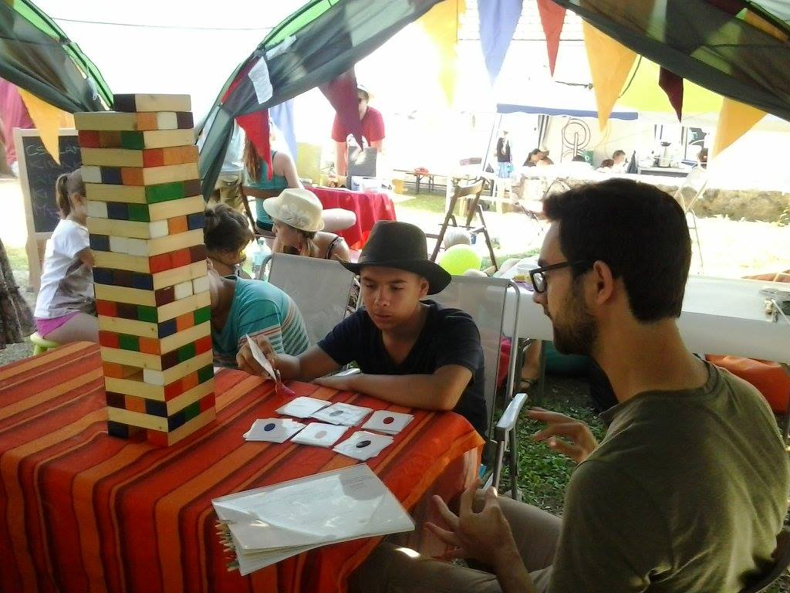
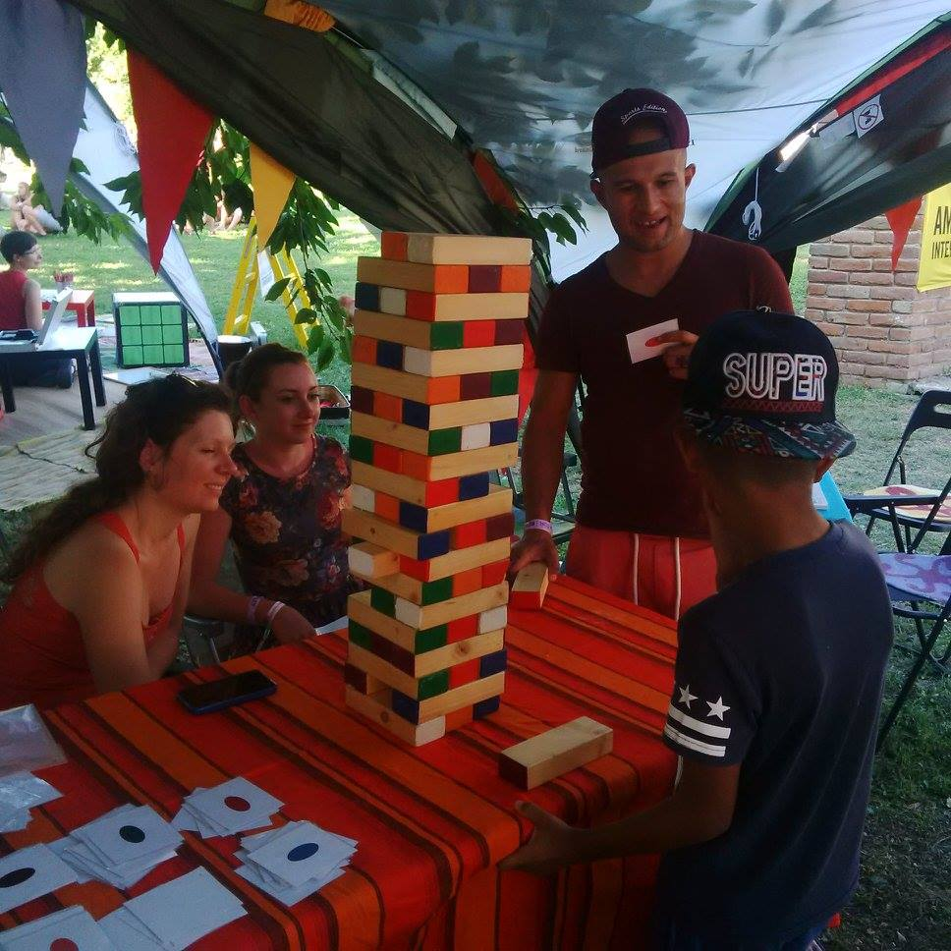

Slide 14
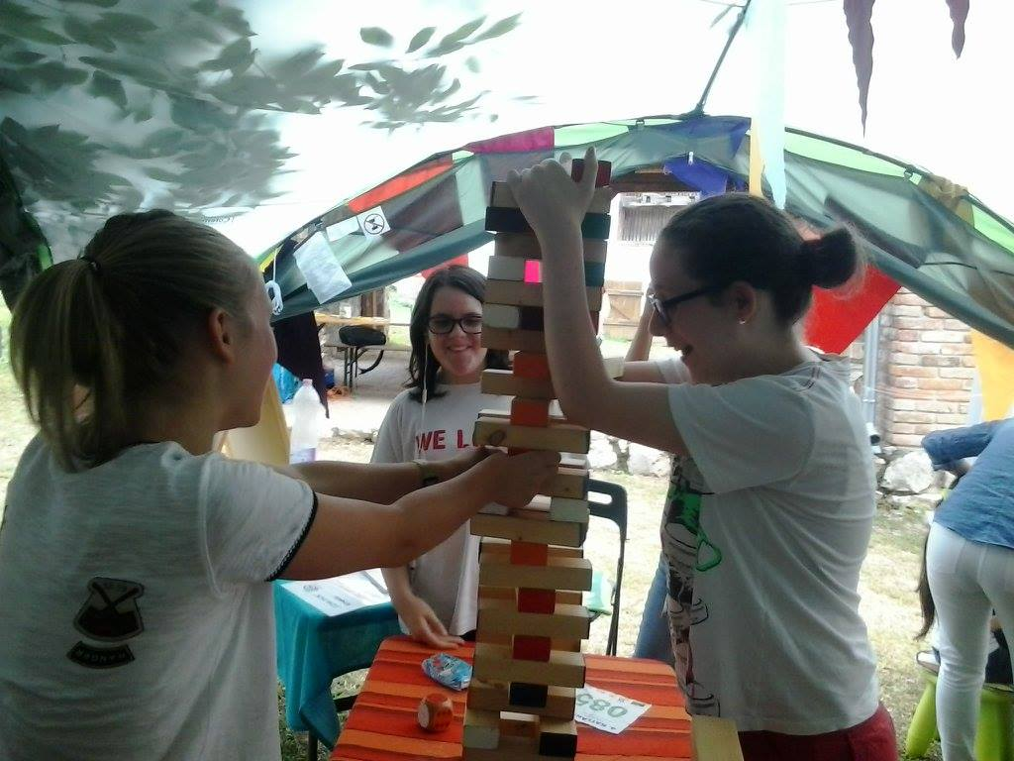

Slide 15
Conclusions
The concept is ok, participants enjoyed the game
Some quetions are still not „easy” enough
We need some more questions in addition to the existing 60 questions

Slide 16
THANK YOU!

